Slide 1
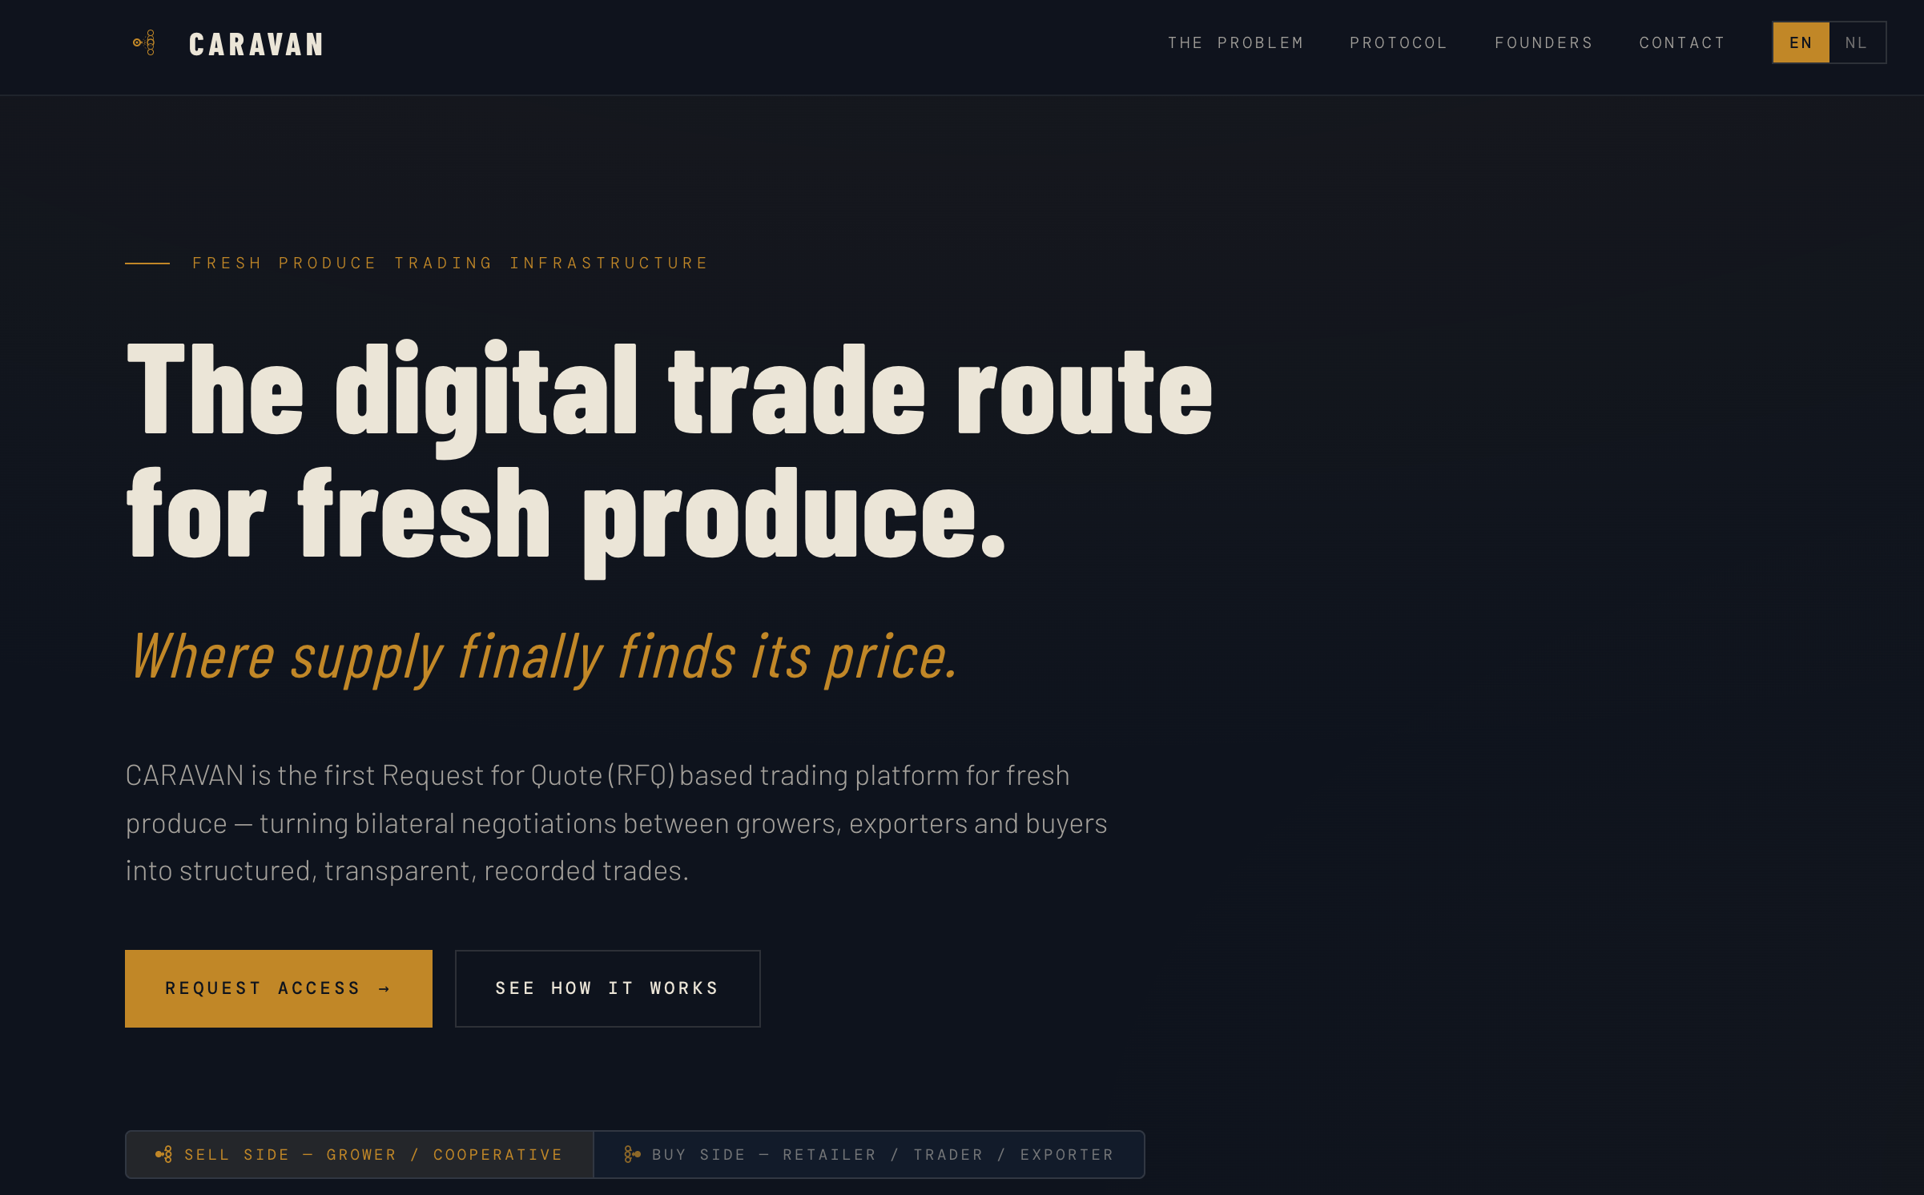
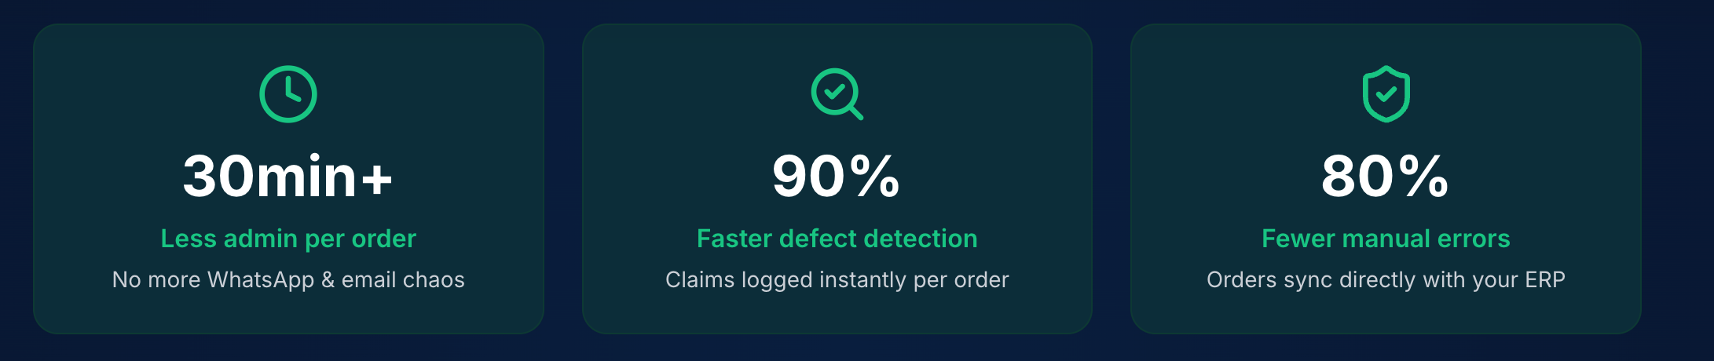
Voor mij dekt dat nog niet de volledige lading als tagline.
Is het niet supply & demand side, meet each other better & faster?
Of “where supply finally finds its market”
RFQ best technische term, mogelijk meer naar wat het kan doen of betekenen formuleren? Voor mij meer ”connecteren met het juiste protocol”
Transparantie mogelijk mee oppassen?
Suggestie van selling proposition :
CARAVAN intuitively connects growers, exporters and buyers on one platform — post your supply or your needs, receive competitive quotes, confirm with one click. Every deal is recorded, traceable and settled automatically.
We kunnen mogelijk success metrics belichten. Wat we denken echt te behalen, qua. Tijd, x% meer deals, … (mss voor latere fase). Deze zijn van Harvex. Pagina hierachter suggesties qua metrics voor Caravan. Zo knn we ook goed bevragen, wat is echt het eindresultaat dat ze willen bekomen met platform.

Slide 2
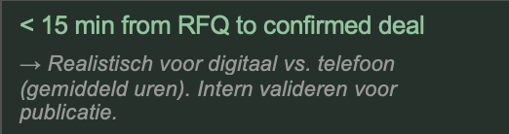
Connects buyers and sellers across Belgium, Neterlands & beyond – one platform, one network.

Slide 3
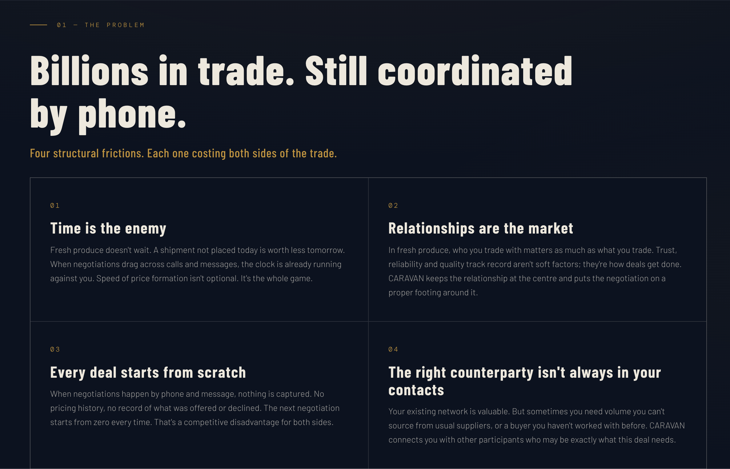
Is it really by Phone?
Or should be use ‘still coordinated manually’
Four structural frictions. Each costing both sides of the trade.
1. Time is the enemy. Fresh produce doesn’t wait. A shipment not traded today is worth less tomorrow. While negotiations drag across calls, messages and spreadsheets, the clock is already working against both sides. Speed shapes price. OF Speed defines value. OF At the core of every trade lies efficient price formation.
02 Relationships are the market In fresh produce, who you trade with matters as much as what you trade. Trust, reliability and proven quality aren’t soft factors ,they are the foundation of every deal. CARAVAN keeps relationships at the centre while giving negotiations the structure they deserve.
3. Every deal starts from scratch When negotiations happen across calls and messages, nothing is captured. No pricing history. No negotiation trail. No record of what was offered, accepted or declined. Every new trade starts from zero, creating inefficiencies fro both sides of the market. OF Markets become mor efficient when information compounds over time.
4. The right counterparty isn’t always in your contacts Existing relationships remain at the core of the trade. But sometimes you need volume beyond your usual suppliers or a buyer outside your current network. CARAVAN expands your reach while keeping relationships at the centre of the trade.

Slide 4
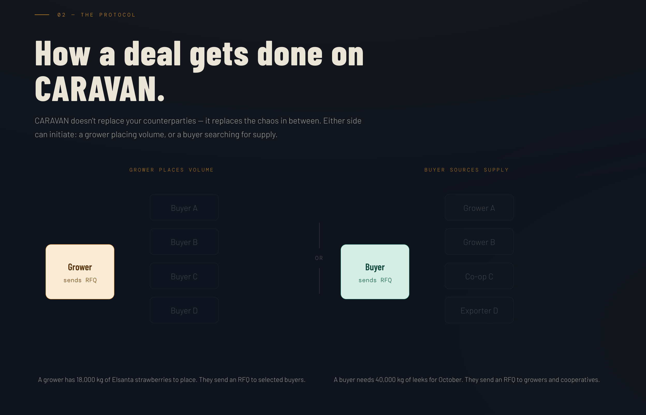
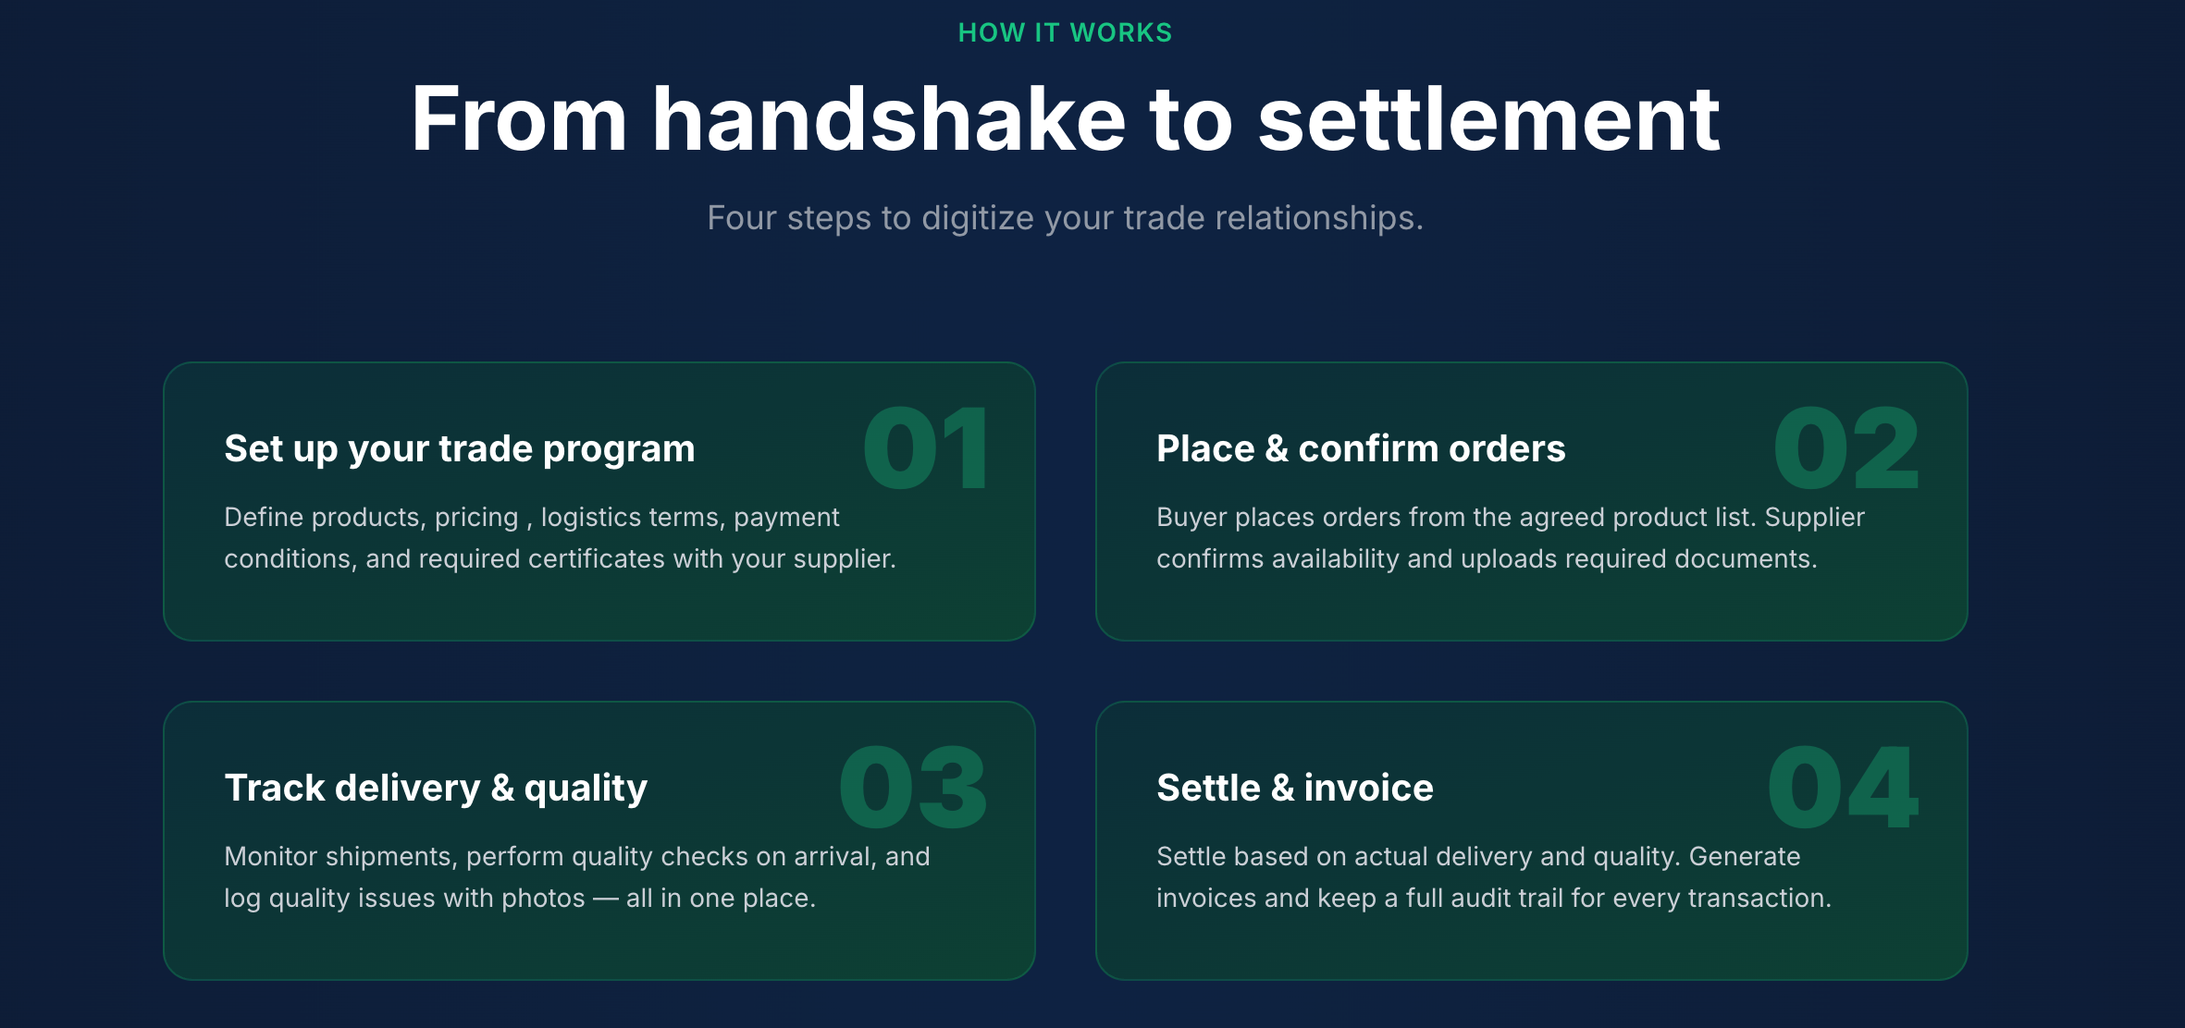
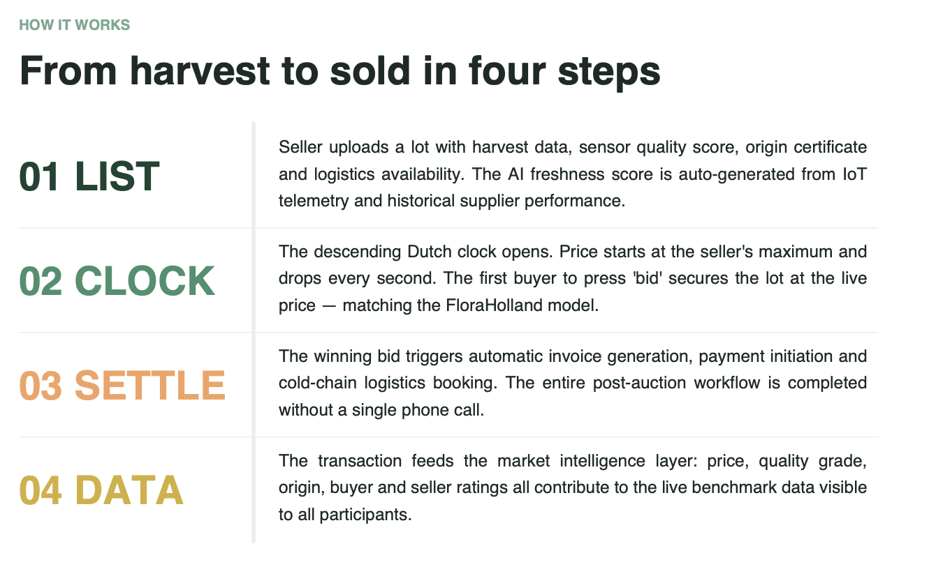
CARAVAN doesn’t replace your counterparties — it replaces the chaos in between. Either side can initiate a trade: growers offering supply or buyers searching for volume.
Doordat de prijzen ernaast staan, lijkt het alsof er prijs transparantie is. Vanuit buy/sell kant.
Mogelijk laten we dit weg?
Het prototype daarboven, en dit gaat best snel. Mogelijk kunnen we er in vervolgstap nog heel duidelijk de stappen neerschetsen eg. Harvex example of bij draft Bloom pdf. Heb hier screenshots neergezet. Alsook volgende pagina suggesties, voor 4 simpele steps

Slide 5
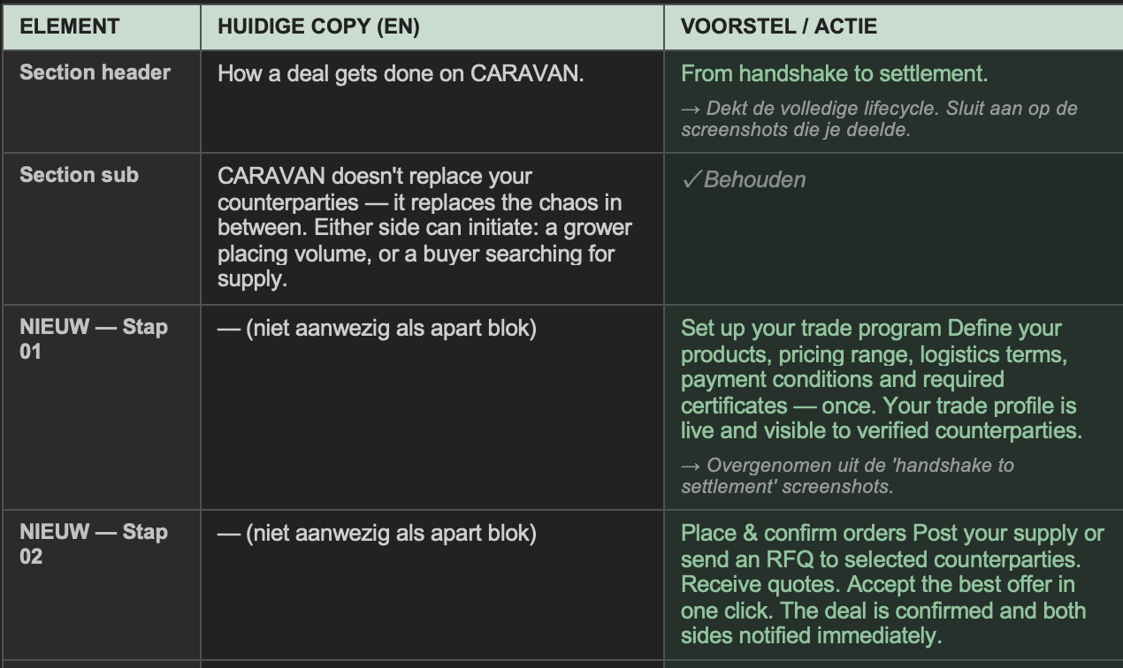
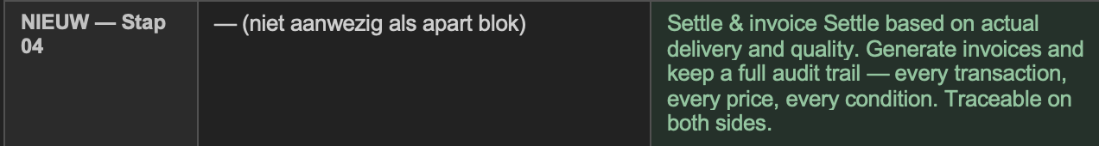
Draft CARAVAN
Example Harvex
Example Bloom Claude

Slide 6
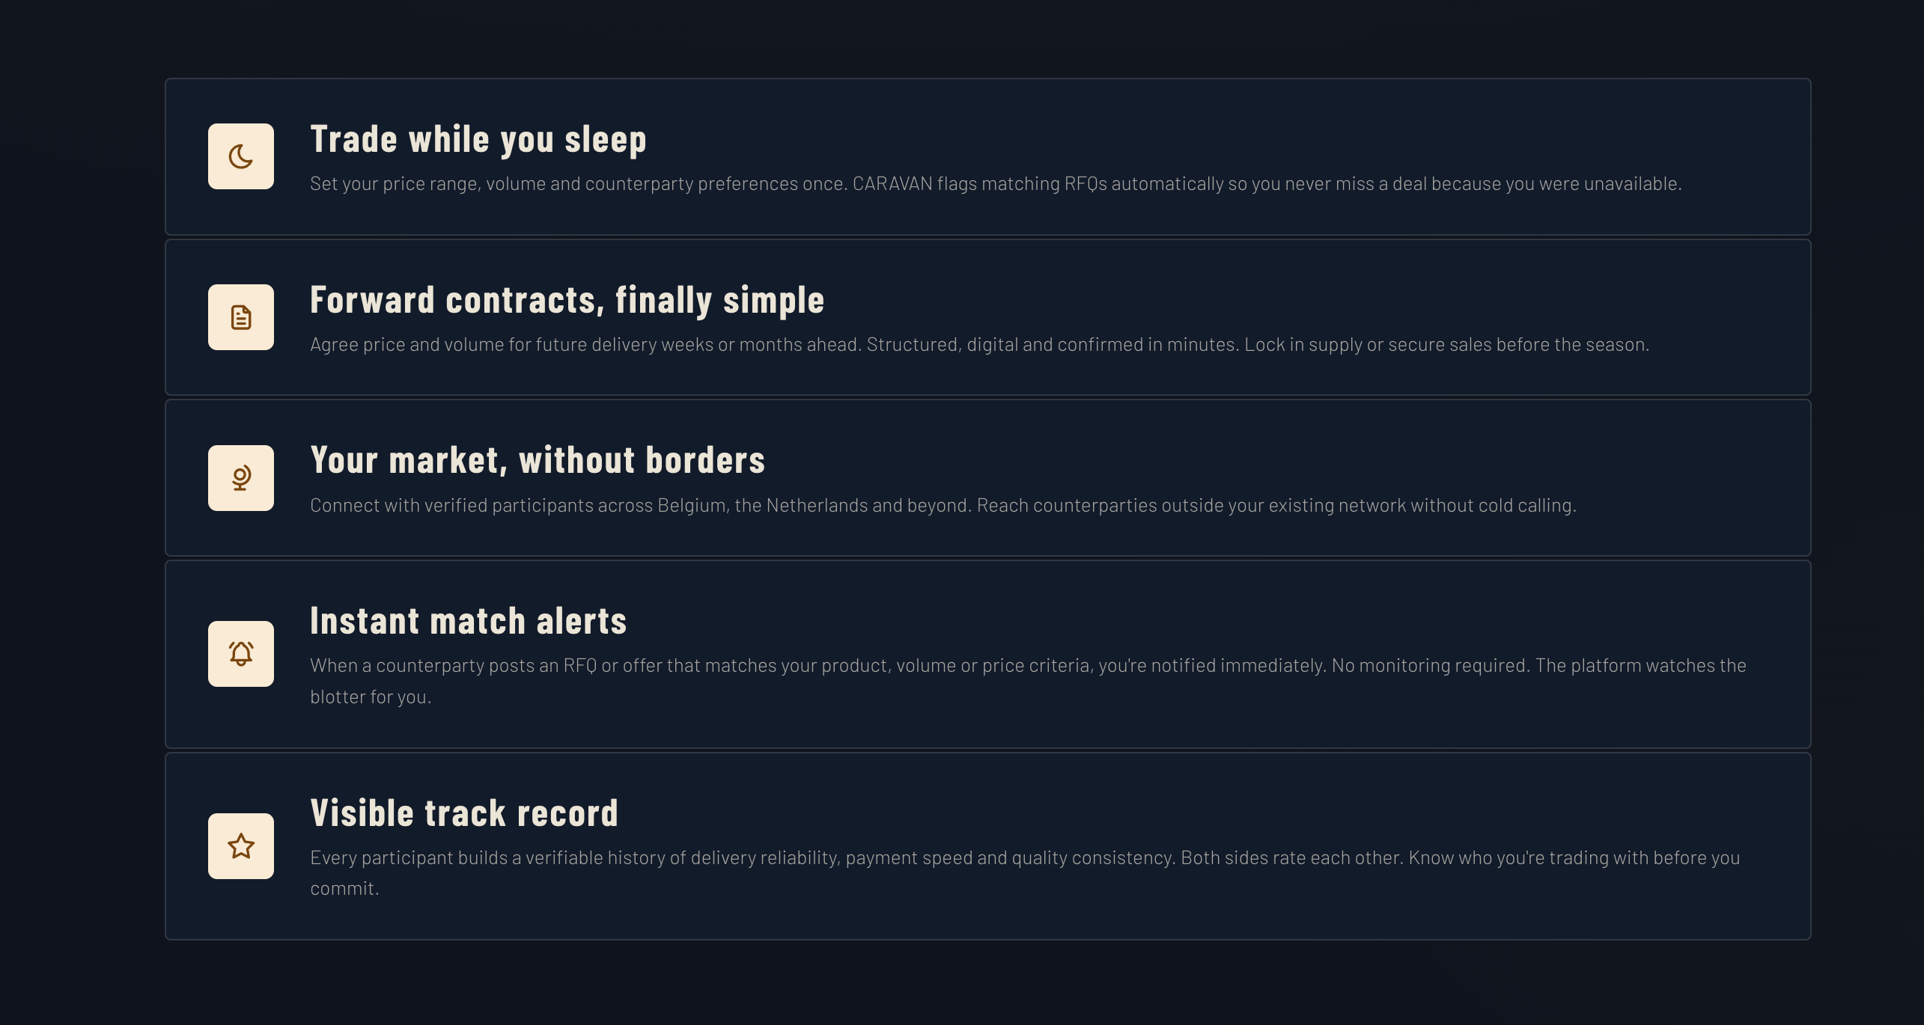
Trade while you sleep Set your preferred price range, volume and counterparties once. CARAVAN automatically surfaces matching RFQs so you never miss a trading opportunity.
Forward contracts, finally simplified Agree on price, volume and delivery timing weeks or months in advance. Structured, digital and confirmed in minutes. Secure supply or lock in sales before the season starts.
Your market, without borders Connect with verified trading partners across Belgium, the Netherlands and beyond. Reach relevant counterparties outside your existing network — backed by verified credentials and trading data.
Your market, without borders Connect with verified trading partners across Belgium, the Netherlands and beyond. Reach relevant counterparties outside your existing network — backed by verified credentials and trading data.
Instant match alerts. OK
Visible track record Build a verifiable trading history based on delivery reliability, payment performance and product consistency. Know who you’re trading with before committing to a transaction.

Slide 7
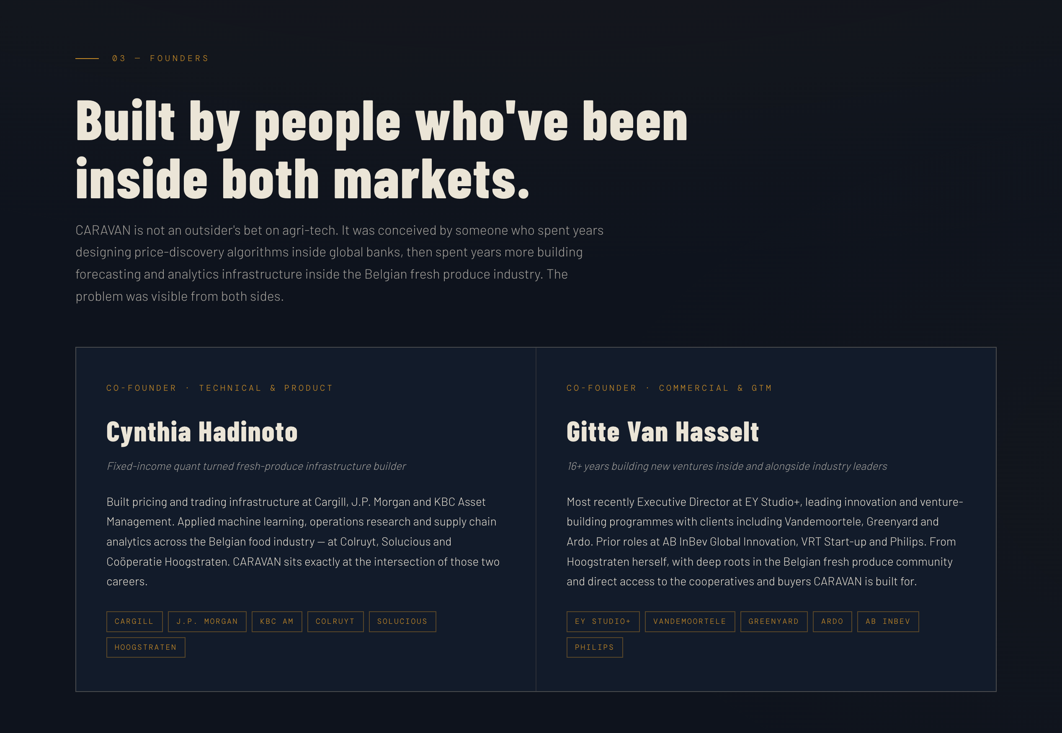
Built by people who’ve operated inside both markets CARAVAN is not an outsider’s bet on agri-tech.
It emerged from years spent designing pricing and trading infrastructure in financial markets, combined with deep operational experience inside the fresh produce industry. The structural inefficiencies became impossible to ignore.
OR
The inefficiencies were visible from both sides.
Cynthia Hadinoto
Fixed-income quant turned fresh produce infrastructure builder
Built pricing and trading infrastructure at Cargill, J.P. Morgan and KBC Asset Management. Later applied machine learning, operations research and supply chain analytics across the Belgian food industry, including projects with Colruyt, Solucious and Coöperatie Hoogstraten.
CARAVAN sits at the intersection of those two worlds: market structure and fresh produce operations.
Gitte Van Hasselt
Co-founder · Commercial & GTM
17+ years building ventures and innovation platforms inside and alongside industry leaders. Most recently Executive Director at EY Studio+, leading venture-building and innovation programmes for clients including Vandemoortele, Greenyard and Ardo. Previous roles include AB InBev Global Innovation, VRT Start-up and Philips.
Originally from Hoogstraten, with deep roots in the Belgian fresh produce ecosystem and direct access to the growers, cooperatives and buyers CARAVAN is designed for.

Slide 8
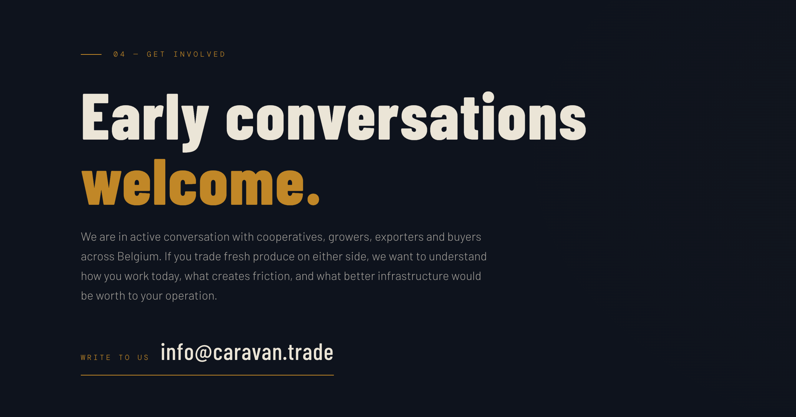
Early conversations welcome We’re actively speaking with cooperatives, growers, exporters and buyers across Belgium. If you trade fresh produce on either side of the market, we want to understand how you operate today, where friction still exists, and what better trading infrastructure would be worth to your business.

